Slide 1
Enablement Requirements for the Three-Party BI System Integration Solution
2021 - 10

Slide 2
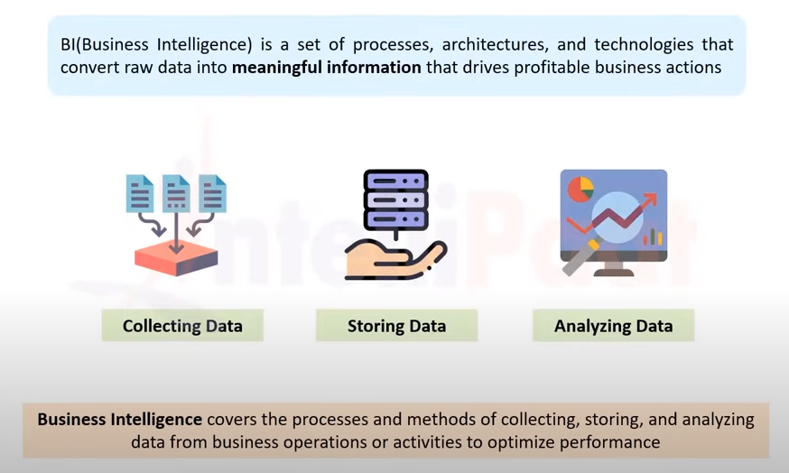
What is BI
Business intelligence (BI) is a technology-driven process for analyzing data and delivering actionable information that helps executives, managers and workers make business decisions.
As part of the BI process, organizations collect data from internal IT systems and external sources, prepare it for analysis, run queries against the data and create data visualizations, BI dashboards and reports to make the analytics results available to business users for operational decision-making and strategic planning.
Common functions of business intelligence technologies include reporting, analytics, dashboard development, data mining, complex event processing, business performance management, benchmarking, text mining, predictive analytics, and prescriptive analytics.
BI technologies can handle large amounts of structured and sometimes unstructured data to help identify, develop, and otherwise create new strategic business opportunities.
Business intelligence can be used by enterprises to support a wide range of business decisions ranging from operational to strategic.
Basic operating decisions include product positioning or pricing.
Strategic business decisions involve priorities, goals, and directions at the broadest level.
BI in a nutshell
https://www.netsuite.com/portal/resource/articles/business-strategy/business-intelligence-examples.shtml

Slide 3
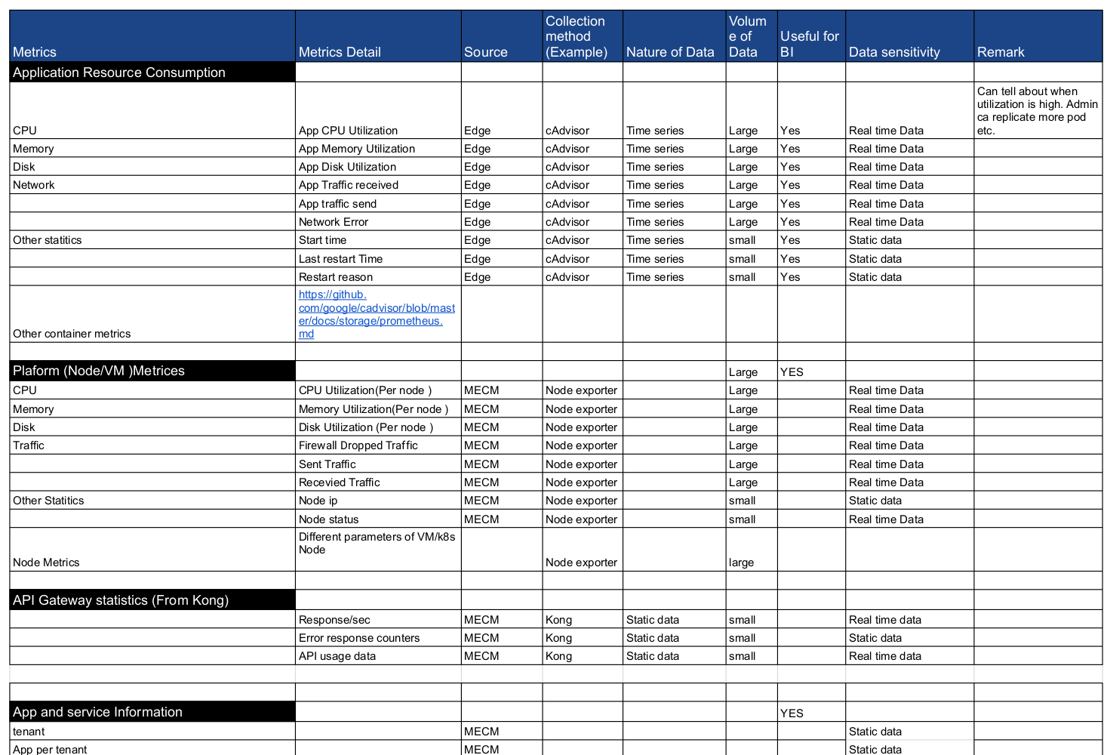
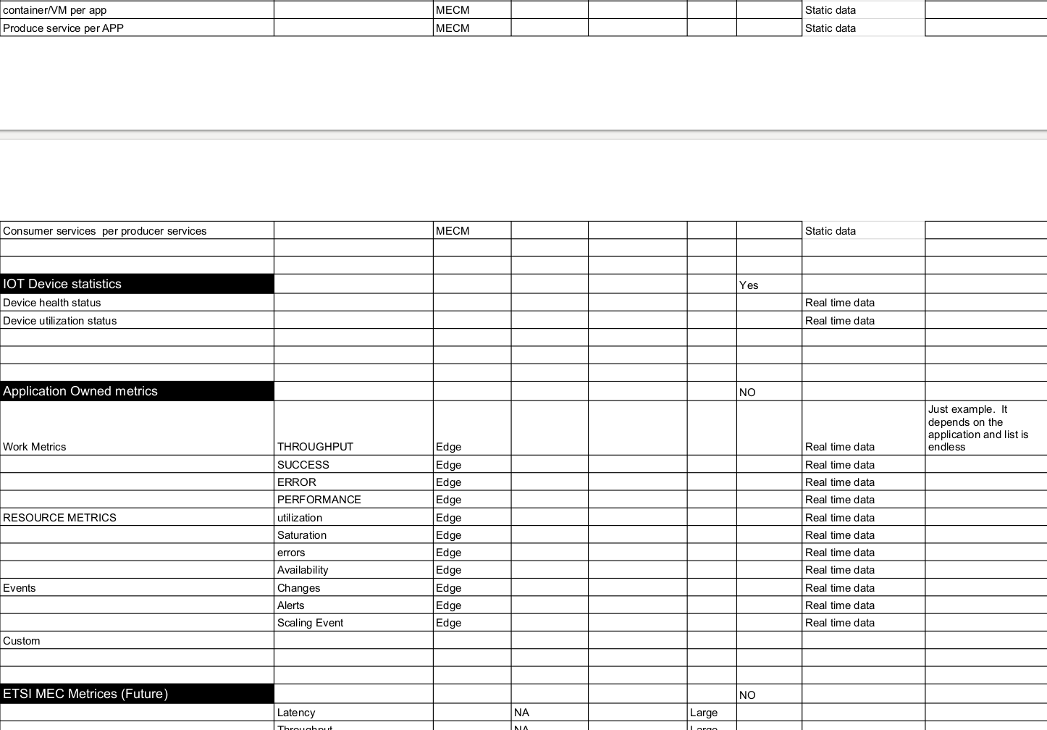
What Data EdgeGallery can provide
Note: Logs are not considered for now. Later based on BI system needs solution can be extended to export logs also.
Notes:
https://docs.google.com/spreadsheets/d/19L0zm-9LEBGslDn4NULlcftUXV9zf7qrPjsam7Msmik/edit?usp=sharing

Slide 4
BI Integration Requirements
The third-party service management system (big front end) integrates with the EG platform.
Security: Should be connected securely
Performance and Scalability: Solution to support multiple edges & multiple metrics (Data velocity, Data Volume and Data Variety to be considered)
Data: A database exposed to 3rd party Application. Will receive data from EdgeGallery. Following are some detailed requirement about data collection and export.
Data collection at Edge: Only relevant data as specified in previous slide should be collected at every edge and to be sent to center node.
Filtering per BI system: Every plugin to filter based on asked data by external BI system
Export data to BI system data source: Data includes both streaming metrics data from edges & relational data from MECM inventory

Slide 5
Analysis

Slide 6
Popular BI systems Analysis
BI Name | License | Database Source Supported | Remarks
Tableau Public | Commercial solution On demand Free version for trial is available | SQL : TimeScaleDB, PostgreSQL, Apache Drill NoSQL: MongoDB | Its majorly a commercial solution OS supported - Windows, Mac
Power BI Desktop | Commercial solution On demand Free version for trial is available | SQL : PostgreSQL, MariaDB, MySQL, Impala NoSQL: MongoDB | Its majorly a commercial solution OS supported - Windows
Apache superset | Apache License | SQL : Spark SQL, Drill, Druid,Hive, Impala, CockroachDB, PostgreSQL, SQLite,SQL Server NoSQL: Cassandra | Apache License OS supported: Linux, Mac OSx
Metabase | AGPL License | SQL : MySQL, PostgreSQL, SQLite, Druid, Presto NoSQL: MongoDB, Vertica, Apache Spark, Snowflake | AGPL License OS Supported: Windows, linux, MAC
Birt | Eclipse Public License | SQL – Works with any JDBC driver.(Eq, PostGresql) NoSQL: Mongodb, cassandra | Eclipse Public License OS Supported: Run using eclipse

Slide 7
Popular BI systems Analysis
BI Name | Database Supported | Remarks
SaCa DataViz | SQL : Mysql,PostgreSQL, Presto, phoenix, druid, impala, H2, hive, memsql NoSQL: mongodb | Free cloud version supports only excel Unable to download Standard version
seal report | Any SQL/ NO SQL Db using LINQ queries | Apache License, Version 2.0 Windows 7, 2008, Windows 8, 2012, Windows 10 or greater
Conclusion:
External DB:
SQL DB: PostgreSQL
NO SQL DB : MongoDb
BI system: Apache Superset/Metabase/Tableau public

Slide 8
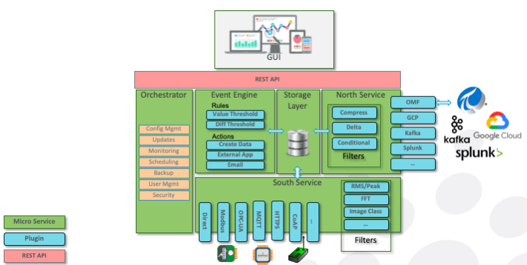
Reference Architecture: Fledge
Northbound Microservices
Northbound microservices offer bi-directional communication of data and metadata between the Fledge platform and larger systems located locally or in the cloud. Larger systems may be private and public Cloud data services, proprietary solutions or Fledge instances with larger footprints. Northbound components are typically deployed as one-shot tasks, which periodically spin up and send data which has been batched, then spin down. However, they can also be deployed as continually-running services.
Takeaway: Plugin based architecture would be useful for exporting data to different BI data source(s).

Slide 9
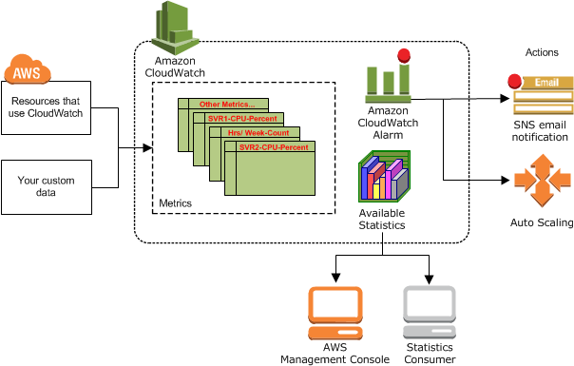
https://docs.aws.amazon.com/AmazonCloudWatch/latest/monitoring/cloudwatch_architecture.html
Reference Architecture: Amazon cloudwatch
Amazon CloudWatch monitors your Amazon Web Services (AWS) resources and the applications you run on AWS in real time. You can use CloudWatch to collect and track metrics, which are variables you can measure for your resources and applications.
You can create custom dashboards to display metrics about your custom applications, and display custom collections of metrics that you choose.
You can create alarms etc.
AWS services publish metrics to CloudWatch.
Example:
By default, Amazon EC2 sends metric data to CloudWatch in 5-minute periods.
with AWS IoT, the service sends the following metrics and dimensions to CloudWatch every minute.
Outpost sends metrics to cloudwatch
Metrics example:
ConnectedStatus
CapacityExceptions
InstanceFamilyCapacityUtilization etc.
Takeaway: Push based mechanism is useful
Data sources are high
When we have to export mix of data (real time & non real time)

Slide 10
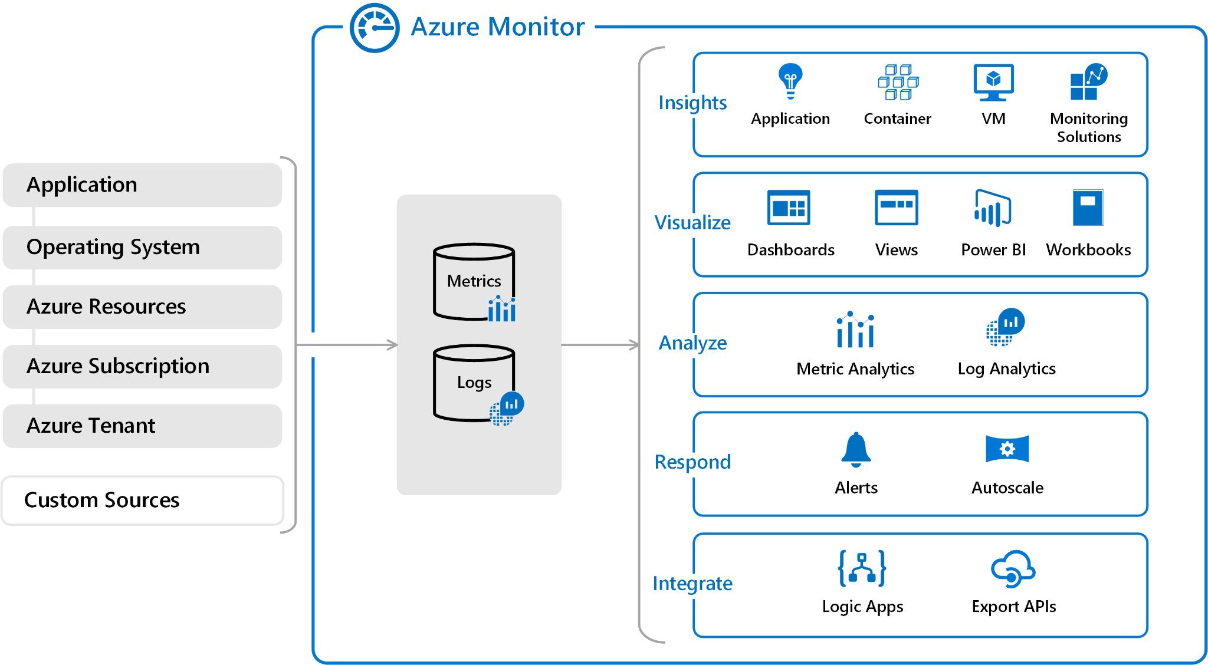
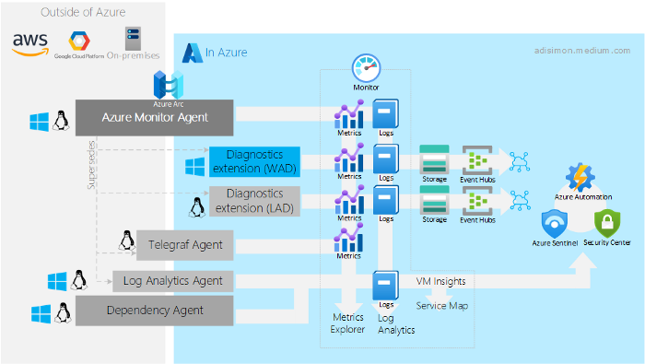
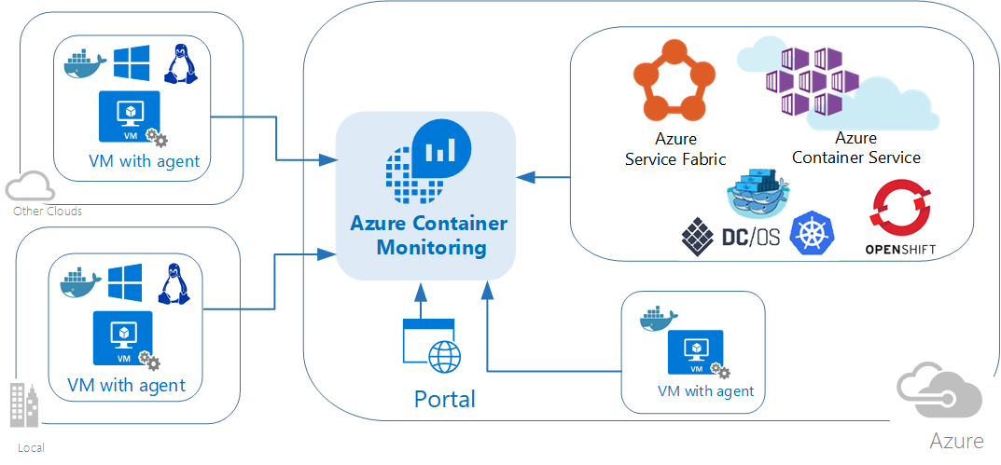
https://docs.microsoft.com/en-us/azure/azure-monitor/agents/agents-overview
Reference Architecture: Azure AKS
(left)Azure monitor runs in cloud and store data for insight. It collects data using various Agents(Right side image). Azure monitor agent is currently evolving and going to replace oher Agents in future.
Takeaway: Push based mechanism is useful
Data sources are high
When we have to export mix of data (real time & non real time)
Example for container insight

Slide 11
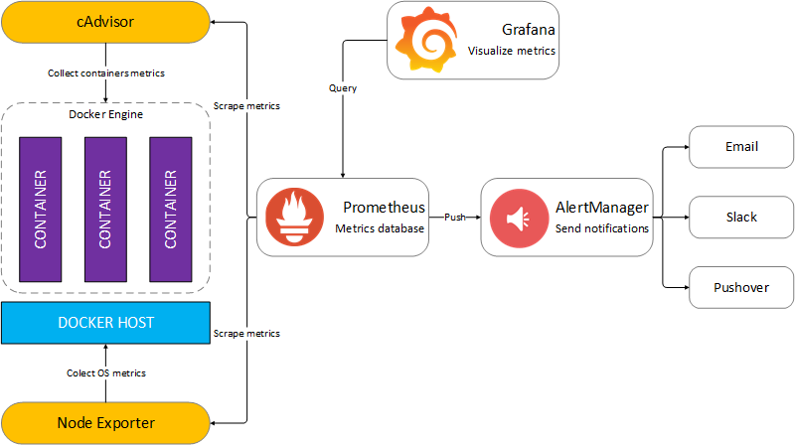
Reference Architecture: Prometheus with Cadvisor
Briefly, the idea is to collect information about containers using cAdvisor and put them into Prometheus database. Grafana will query the Prometheus database and render monitoring charts / values.
cadvisor keeps latest two minute of data. You can configure it to keep more or less.
It has API to push data to db or some other system.
Prometheus pull/scrape data out of cadvisor or other collectors.
Pull makes sure less congestion of traffic.
Use promQL language to query data from prometheus for visualization.
Prometheus doesn’t push data out. So need to write plugin to get the data out. Some DB eg. influxdb gives api to write data from prometheus to influxdb.
Takeaway: Prometheus based system for data aggregation.

Slide 12
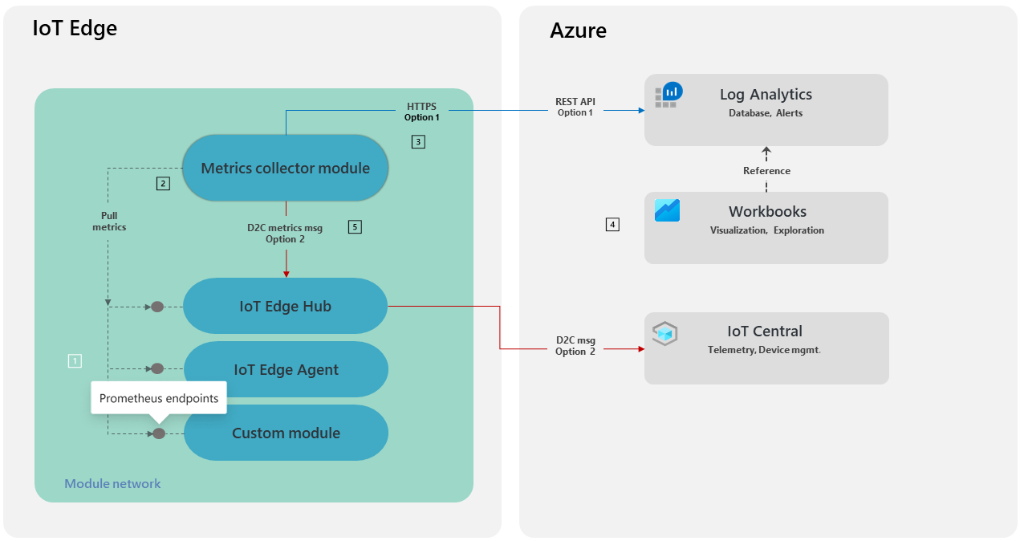
https://docs.microsoft.com/en-us/azure/iot-edge/how-to-collect-and-transport-metrics?view=iotedge-2020-11&tabs=iotcentral
Reference Architecture: Azure IOT Edge Monitoring
Push to the cloud using rest API
1 All modules must emit metrics using the Prometheus data model.
2️ The metrics-collector module is a Microsoft-supplied IoT Edge module that collects workload module metrics and transports them off-device. Metrics collection uses a pull model. Collection frequency, endpoints, and filters can be configured to control the data egressed from the module.
3️ You have two options for sending metrics from the metrics-collector module to the cloud.
Option 1 sends the metrics to Log Analytics. This table's schema is compatible with the Prometheus metrics data model.
Option 2 sends the metrics to IoT Central. This option lets an operator view the metrics and device telemetry in a single location. The collector module can be configured to send the collected metrics as UTF-8 encoded JSON device-to-cloud messages via the edgeHub module.
Pull inside edge to collect data from collector endpoints in prometheus format.
Takeaway:
Data aggregation at Edge: It reduces network traffic which could be bottleneck if multiple collectors sends data directly to center.
Push based mechanism to send data to center location: Data sources are high & have some data which is needed in real time.

Slide 13
Streaming solutions Analysis
 | Description | Sink Database support | Filtering support | Stream Support | Scalable | Latency/Throughput | Remarks
Kafka Connect | Kafka Connect is a framework to stream data into and out of Apache Kafka. The source should be always kafka. | Fully managed: Postgresql, mongodb atlas | Filter SMT (Include or drop records that match a configurable filter.condition) | Yes For each sink need to have one specific connector. NO batch processing | Yes Support parallelism and distributed mode. | high but no data available yet | SMT can be installed using confluenthub. Need to find out solution how to use inside docker where kafka-mogodb-connect is installed.
Apache Flink | Flink’s features include support for stream and batch processing, sophisticated state management, event-time processing semantics, and exactly-once consistency guarantees for state. The source can be many. | No readymade sink connector for mongodb. Postgres can be supported using jdbc connector | No readymade, need to write java/scala/python function to support filtering | Yes Also support batch processing | Yes Support parallelism and distributed mode. | 720,000 events per second | No readymade code available, so need to write everything.
For moving data out from kafka to outside both Kafka connect and Flink can be worked. Kafka connect has many available solutions to send data to different flavour of sink. For flink we need to develop it. Flink also support batch processing if required.
Takeaway:
For current requirements for BI coordination integration, Kafka Connect would be an ideal solution & Apache Flink will be an overkill.
Notes:
https://www.confluent.io/blog/apache-flink-apache-kafka-streams-comparison-guideline-users/

Slide 14
Proposed Solution

Slide 15

Collectors at Edge
cadvisor
Tableau BI
BI System 2
Node exporter
Other Exporter(s)
MongoDB
Other DB
Kafka-prometheus-adapter
Prometheus
BI Integrator - Exporters
Edge Cloud 1
Kafka-mongodb-sink-connector
Kafka-other-sink-connector
Collectors at Edge
Kafka-postgres-source-connector
MECM Inventory
cadvisor
Node exporter
Kafka
Other Exporter(s)
Kafka-prometheus-adapter
Prometheus
Central Cloud
Open source Components
External
Edge Cloud 2
Notes:
https://grafana.com/blog/2021/05/26/the-future-of-prometheus-remote-write/
https://blog.timescale.com/blog/simplified-prometheus-monitoring-for-your-entire-organization-with-promscale/
https://docs.timescale.com/timescaledb/latest/tutorials/promscale/promscale-install/#install-promscale

Slide 16




Notes:
https://grafana.com/blog/2021/05/26/the-future-of-prometheus-remote-write/
https://blog.timescale.com/blog/simplified-prometheus-monitoring-for-your-entire-organization-with-promscale/
https://docs.timescale.com/timescaledb/latest/tutorials/promscale/promscale-install/#install-promscale

Slide 17
Components Details
Component | Usage | Why | Alternate option | Remark
cadvisor | Collect container information cpu,memory, disk etc. | To collect container data for monitoring | None, its integrated with kubelet | Run along with kubelet. So each node will have one cadvisor instance.
Node exporter | Collect node status | Collect node data for monitoring | telegraf, [Seems to has more overhead, also can’t disable metrics which are not required.]
Prometheus | Scrape metrics from all the exporter and send to central location | Prometheus is standard for data monitoring. It has pull based mechanism to scrape data from different exporter (interval and scrape param can be configured.). Scraping runs as job which is good for cpu. It has remote write mechanism to send data out, and support many plugins. Write queue is configurable. We can tune it for edge memory availability. Storage is configurable and can be tuned as per edge requirement. | Metric server can’t be used for metric collection.Its meant for autoscaler. InfluxDB with TICK stack. In this case influxDB to be setup on remote, and telegraf to be run on each node. Its difficult to scale, since all collectors has to send many messages to center. Also in this case influxDB will be the DB stay in center which is not ideal for our case
Push based central data collection | Prometheus push (remote write) to kafka | Push based is better in case of edge scenario where connection may lost intermittently. Prometheus can retry (configurable) to send data if connection is failed. Also scraping interval + polling interval(from center) will make data to be received with much more delayed. We observe many solutions use the same method.(Check Arch reference pages for more info) | Pull based. In that case we need some component to pull data from edges to center. Federated prometheus (Which need another prometheus to be run at center)

Slide 18
Components Details
Component | Usage | Why | Alternate option | Remark
 |  | Also in push based approach we don’t have to look for endpoint discovery at center when new edge cluster will be added.
Kafka | Receive Data from prometheus | BI coordinator can receive message from Kafka and sync to any DB. It can write to internal DB or push to external DB or both. Also Kafka can be useful for scaling.
Plugins | Kafka connect | Its easy to configure, Support requirements for filtering, Can support custom filter, support runtime configuration for connectors. Source connect to get data to kafka from inventory Sink connect to send data out to external system

Slide 19
Example Configurations for open source components
Prometheus | global: external_label remote_write: url = kafka remote_timeout: 30s queue_config: capacity: 10000 max_samples_per_send: 3000 batch_send_deadline: 10s min_shards: 4 max_shards: 200 min_backoff: 100ms max_backoff: 10s Exporters: node exporter cadvisor
Cadvisor | Default configuration
Node Exporter | cpu, network, memory, disk related metrics only
kafka | db retention time
Kafka-connect plugins | mongodb.properties: connection.uri name topics transforms Auth connector.Properties: bootstrap.servers plugin.path

Slide 20
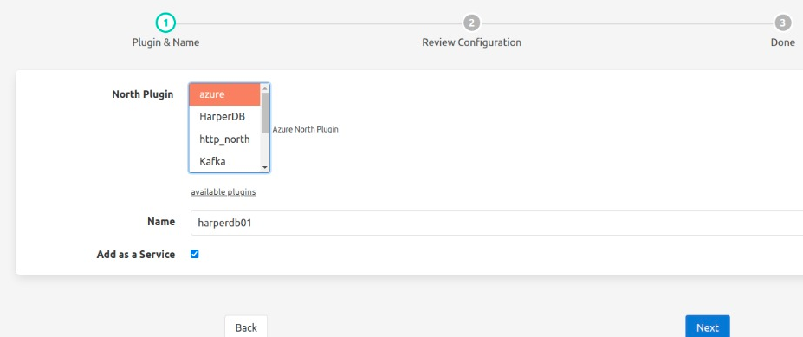
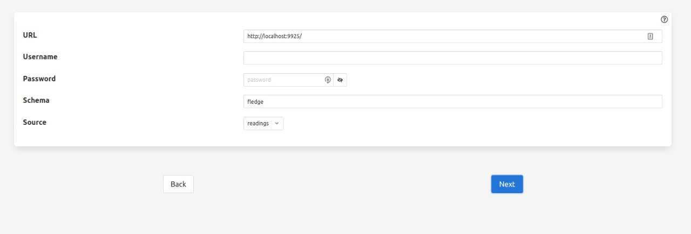
BI Integrator (Plugin Manager) UI - Future
Select plugin (Reference From fledge)
Provide credential for external DB(Reference From fledge)
Plugin selection (BI coordinator)
plugins (Drop down)
Name (Text)
Credential (BI coordinator)
URL
Username
Password
Filter(Future)
Database

Slide 21
Authentication Flow - Future
BI User
External DB
User Mgmt
BI Integrator
(Plugin Manager)
Login to Edgegallery portal
Go to BI coordinator UI
Select Plugin
Register External DB ( provide URL, Credential)
Select Filter (Future)
Store DB and credential
Enable plugin
Write to DB (Credential)
Use DB as BI data source
Note: In EG 1.5 release, BI Integrator plugins will get authentication information from user during Ansible deployment
Plugin Manager can be considered in future for dynamically starting and configuring new Plugins

Slide 22
E2E Flow
BI User
External DB
BI Integrator
(Plugin Manager)
Kafka
Kafka adapter
Prometheus
Collector(s)
Pull data from collector
convert and put data into kafka
Push Data to kafka adapter
BI coordinator received subscribed topic
Register DB
Write Data to DB
Pull Data from DB
Center
Edge
External

Slide 23
BI Integrator - Deployment Scripts
Ansible playbook for Deployment
- BI Integrator Collector + Edge Adapter - 1 playbook
- BI Integrator Exporter (except plugins) - 1 playbook
- Per Plugin - 1 Playbook (currently only 1 mongo db connect playbook)
Note: Plugin playbook to include plugin deployment, along with plugin configurations like filter, BI system data source endpoint, Authentication etc.

Slide 24
Demo with Metabase BI
cadvisor
Metabase BI
Node exporter
Other Exporter(s)
mongoDB
Prometheus
BI Integrator - Exporters
Edge Cluster 1
Kafka-sink-connector
Inventory
push
Kafka-source-connector
cadvisor
Kafka
Kafka-prometheus-adapter1
Node exporter
Kafka-prometheus-adapter2
Other Exporter(s)
Central Cloud
Prometheus
Edge Cluster 1
Open source Components
Future
New Development
External
Notes:
https://grafana.com/blog/2021/05/26/the-future-of-prometheus-remote-write/
https://blog.timescale.com/blog/simplified-prometheus-monitoring-for-your-entire-organization-with-promscale/
https://docs.timescale.com/timescaledb/latest/tutorials/promscale/promscale-install/#install-promscale

Slide 25
Thank You

Slide 26
Work Status
Design | Complete
Ansible scripts | Complete
Security and Stabilization | Need to handle
Optimization | Need to complete
User Story | In progress Over all Edge info , tenant info Per Edge Resource info Each cluster Resource Info

Slide 27
BI system - Edgegallery Operator/Enterprise View
Objective: Give Operator/enterprise who own the edgegallery system the analytical view about platform, platform KPIs, platform users(tenants).
Data source:
Edge data: Timeseries Edge platform data, Node/VM data, application cpu/memory/disk/network data
Tenant Information: From central node databases.
Can we demonstrate it: These data are already available. With some correlation we can demonstrate it.

Slide 28
BI system - Edgegallery End User View
Objective: Give tenants analytical view about application, application KPIs, application users.
Data source: Data collection must be supported by application. Application expose the API endpoint to collect metrics and logs. Some open source exporter can collect metric from application endpoint and send them to prometheus or other collector.
Can we demonstrate it:

Slide 29
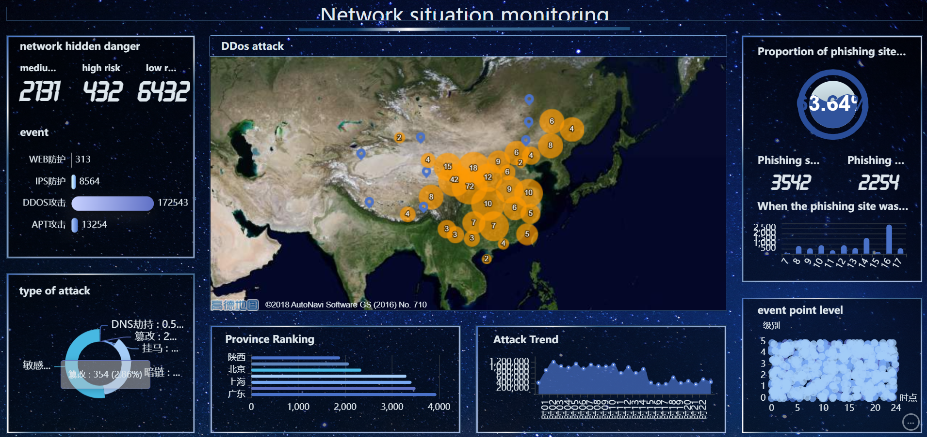
iDataViz
Network Security dashboard

Slide 30
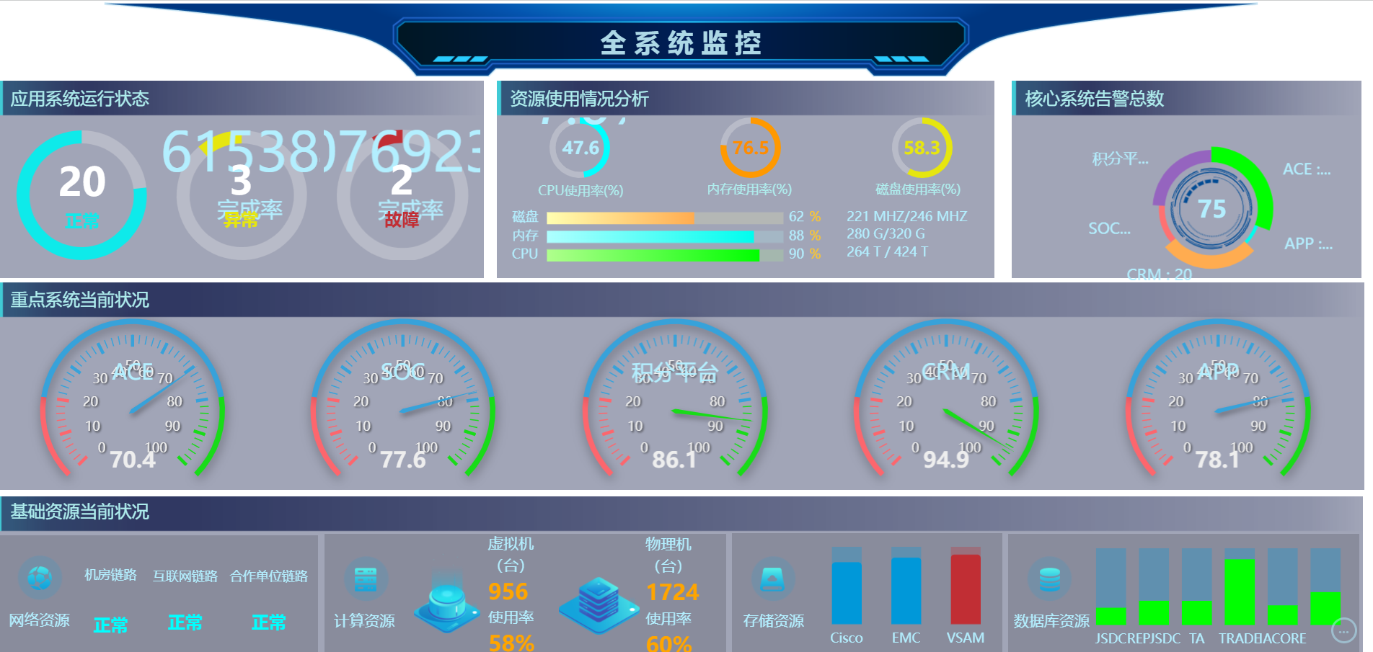
iDataViz
Air china system monitoring

Slide 31
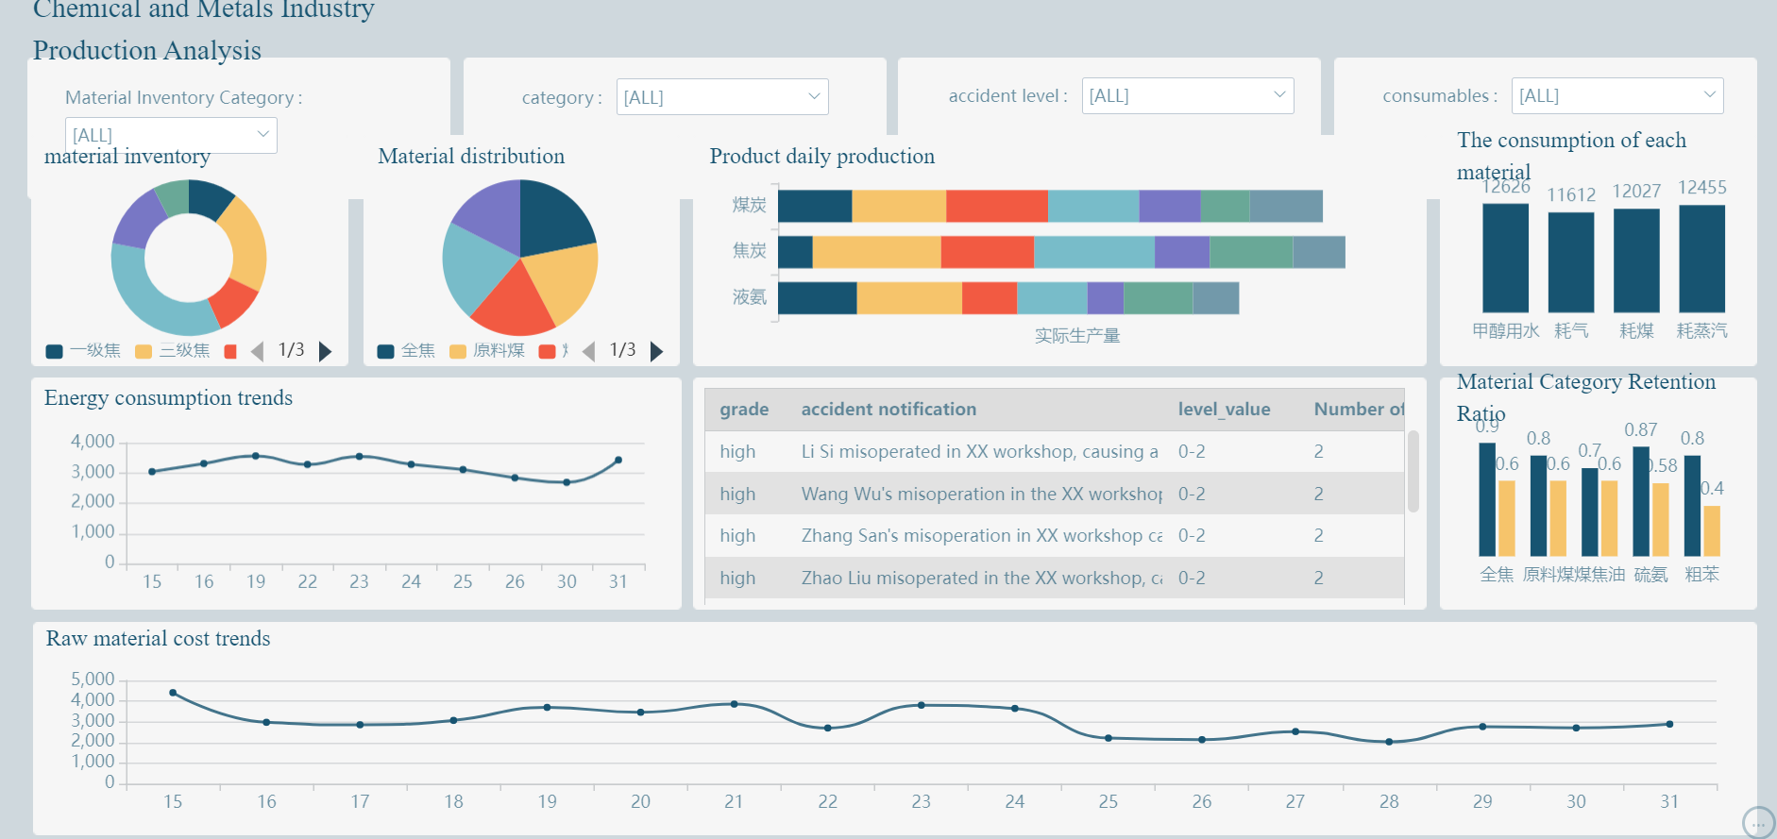
iDataViz
Production analysis (metal industry)

Slide 32
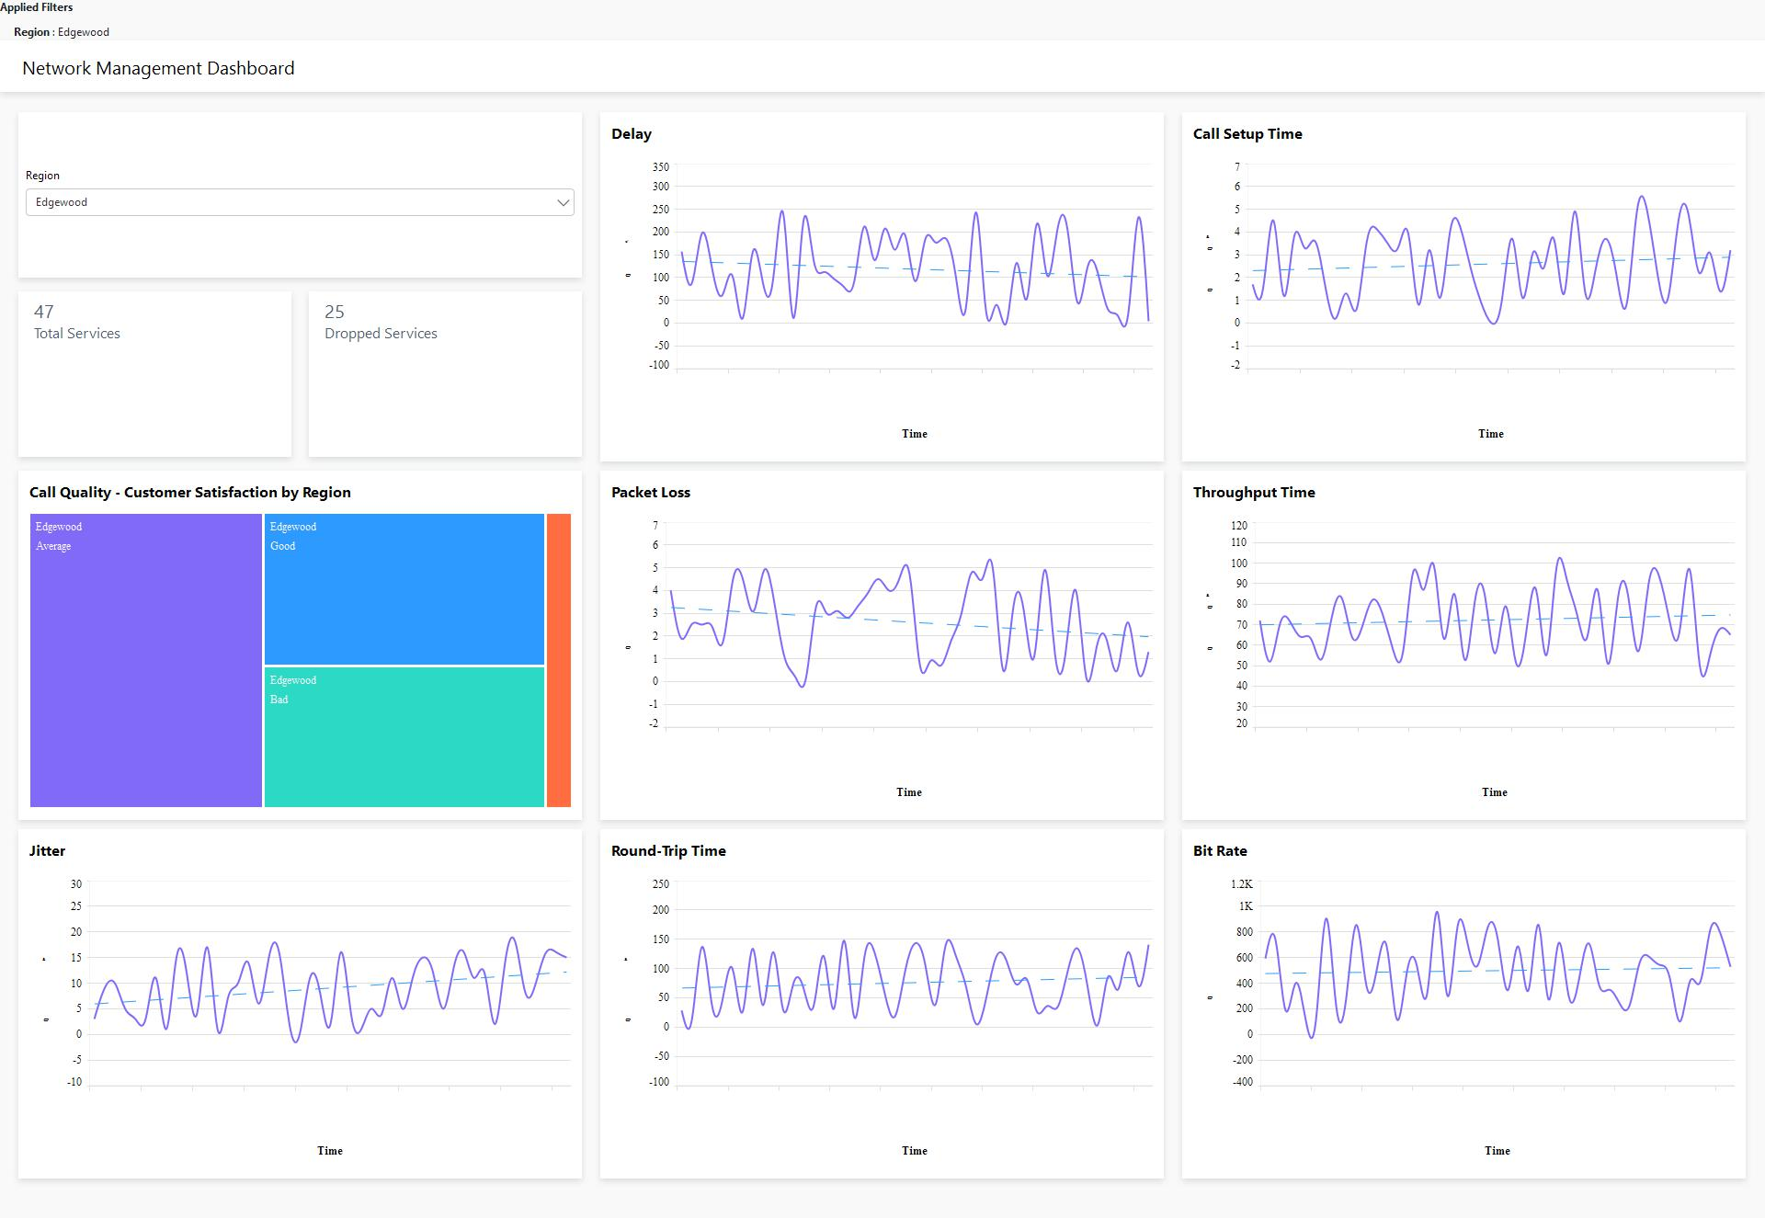
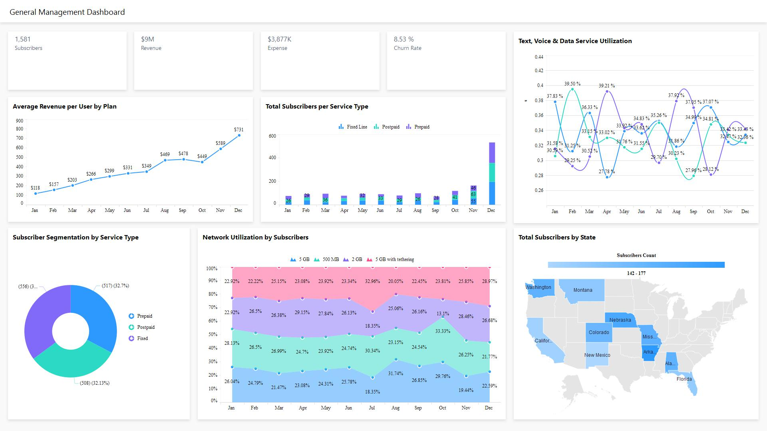
Bold BI
Telecommunication (network management)
Telecommunication (General management)

Slide 33
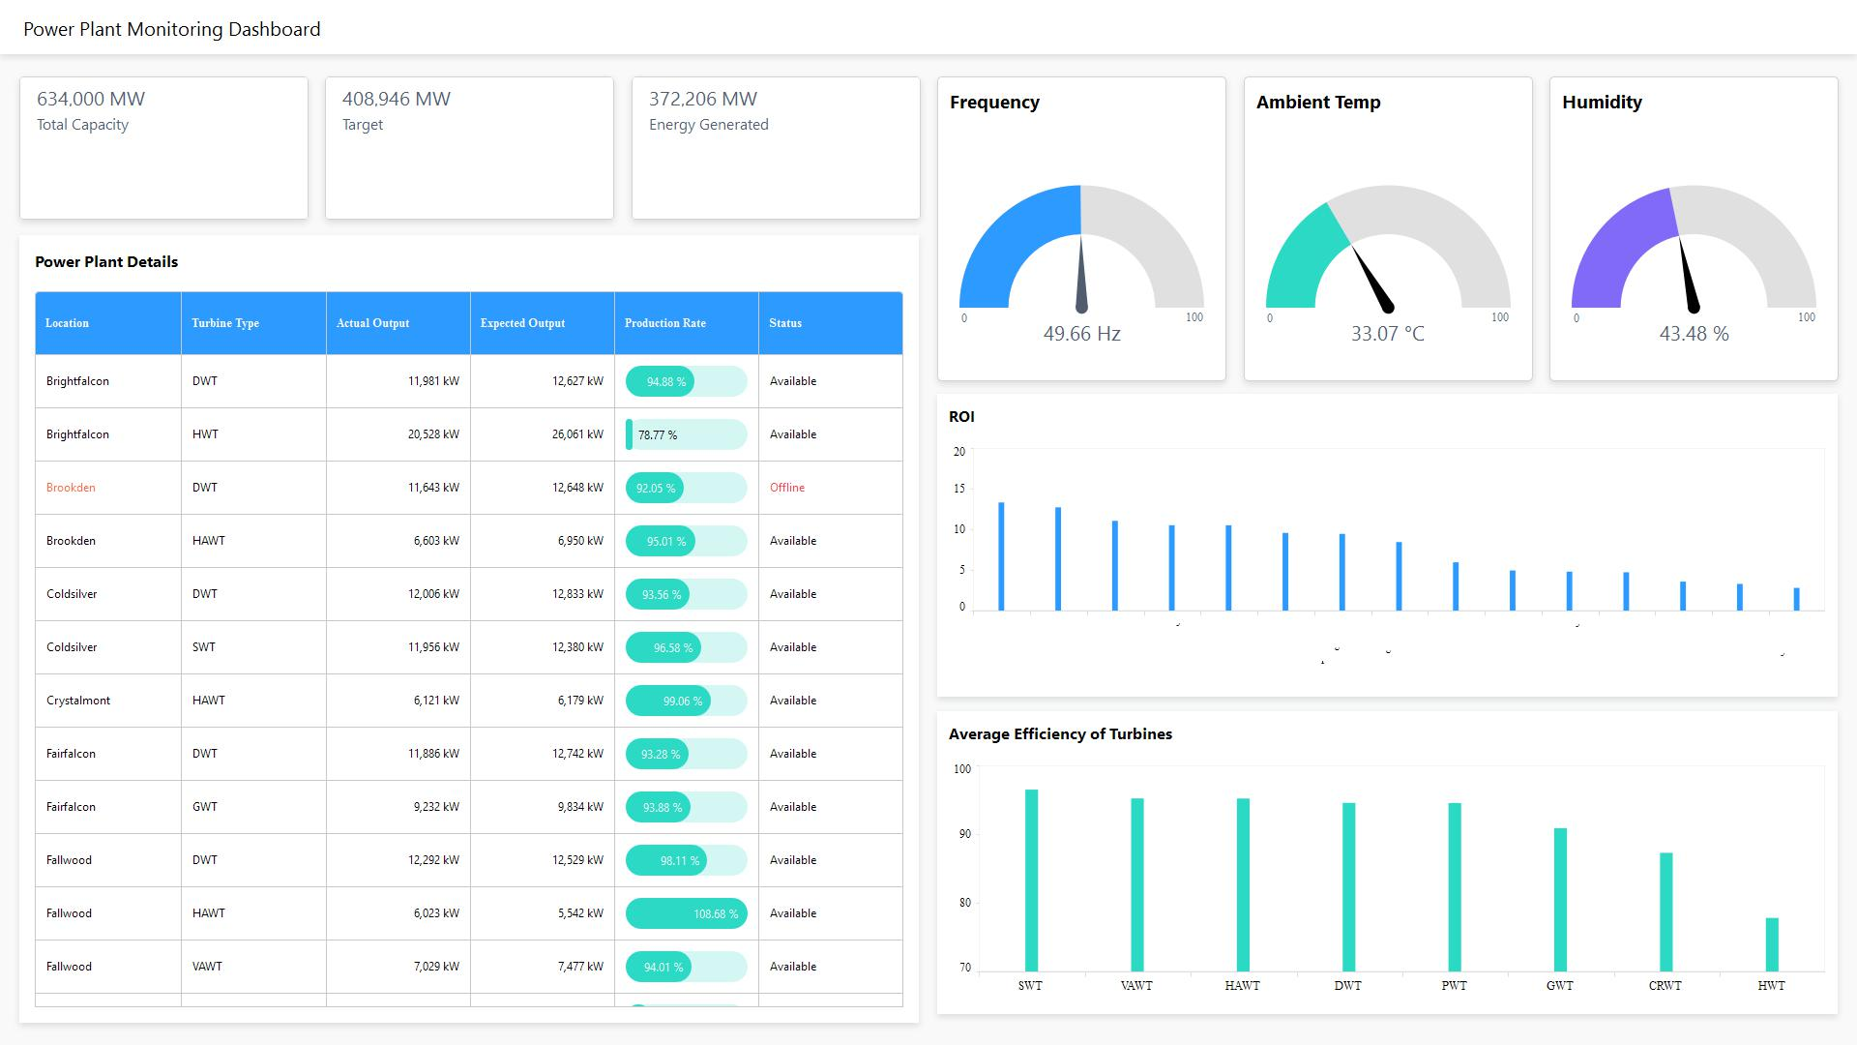
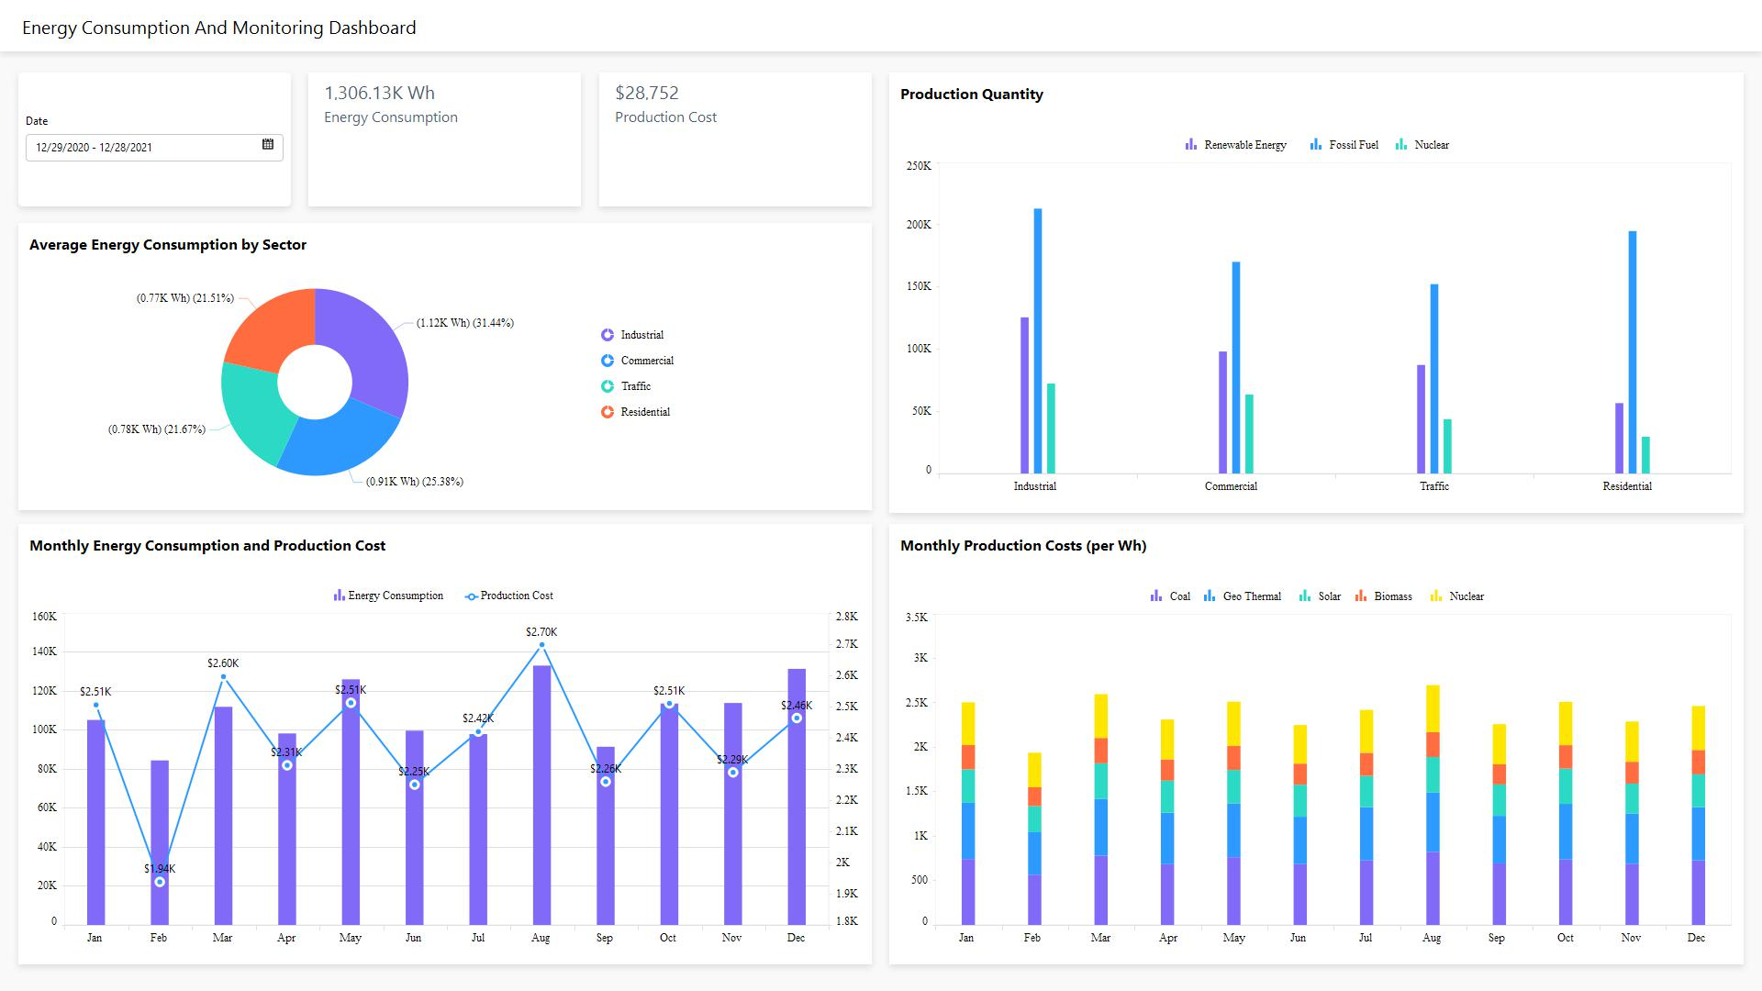
Bold BI
Energy (Power Plant monitoring)
Energy (Consumption)

Slide 34
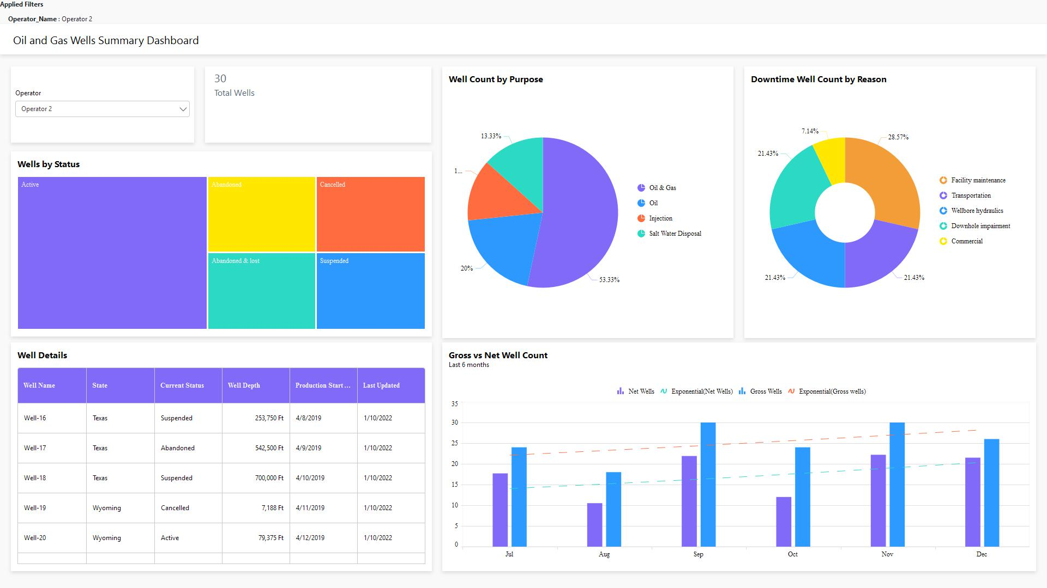
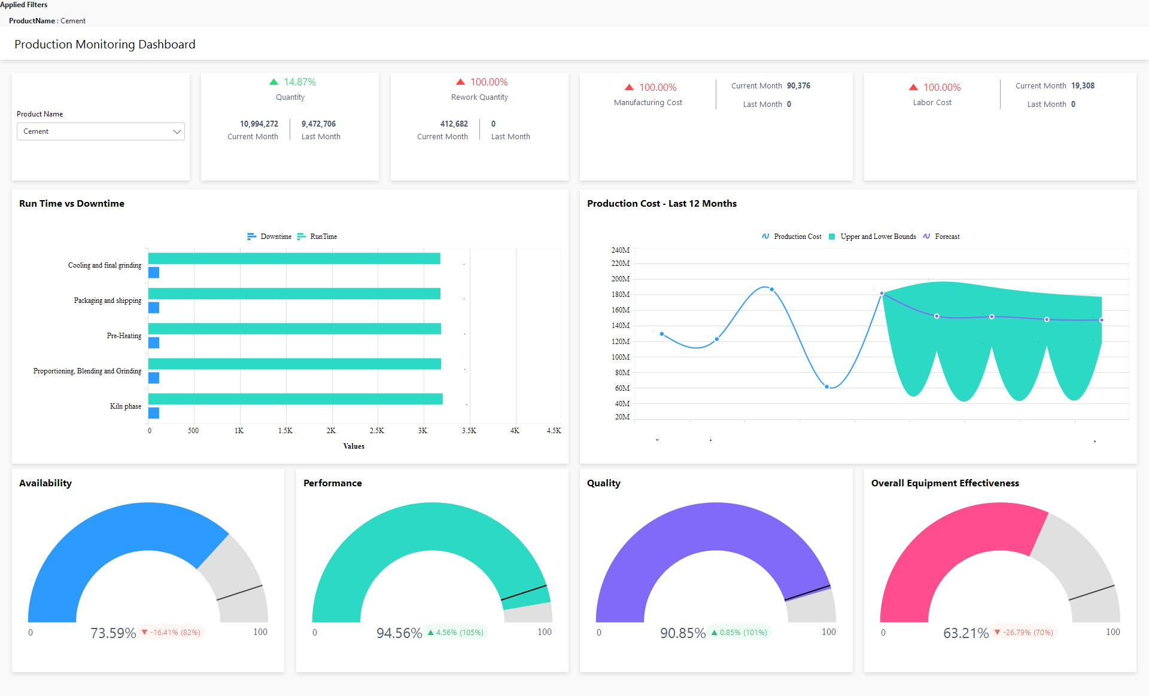
Bold BI
Oil and Gas(Well monitoring)
Manufacturing(Production monitoring)

Slide 35
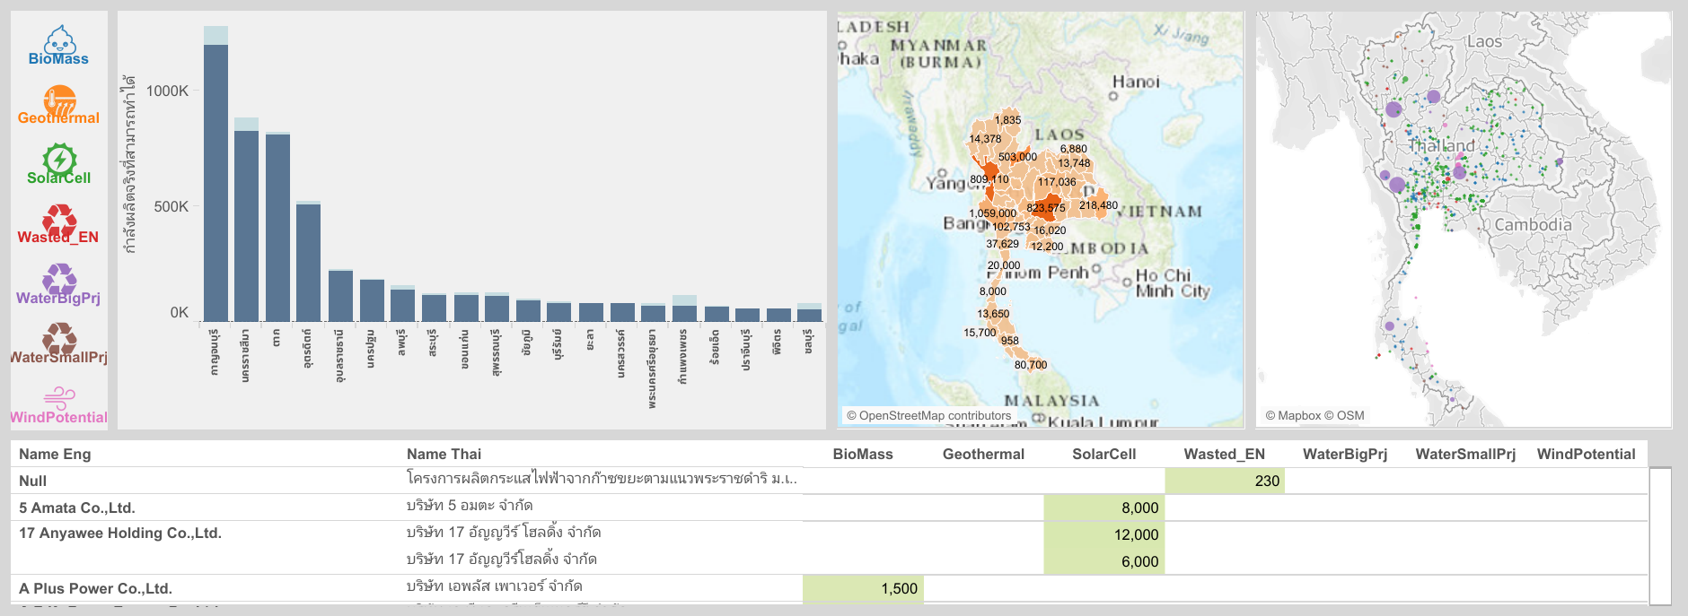
Tableau Public (Posted in community)
Renewable energy

Slide 36
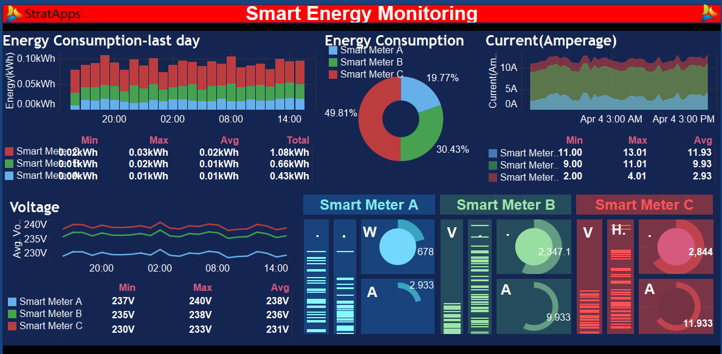
Tableau Public (Posted in community)
no
Smart Energy Monitoring

Slide 37
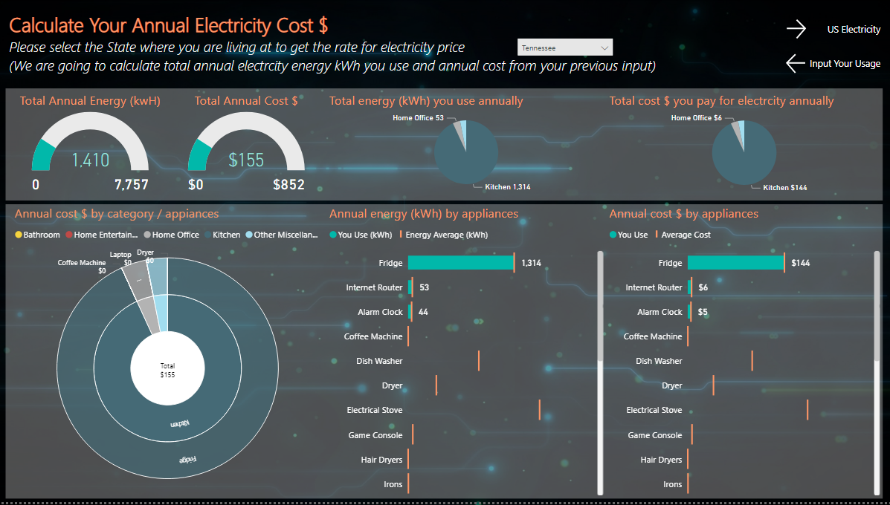
Power BI (Posted in community)
no
Electricity consumption

Slide 38
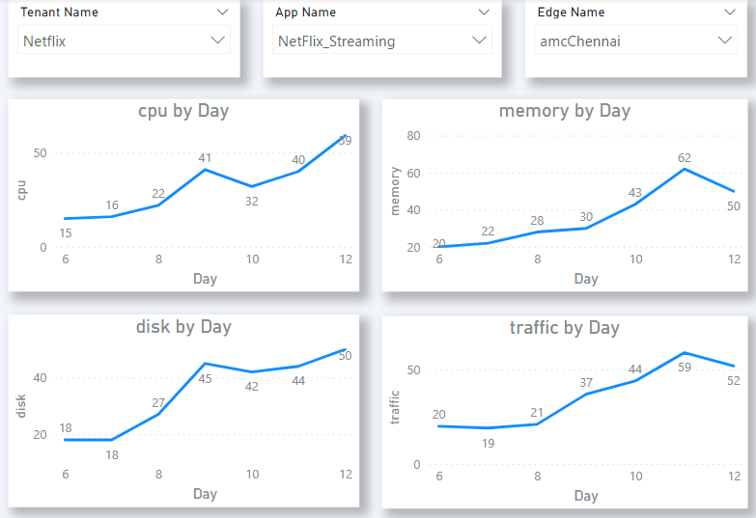
EdgeGallery View
Resource usage for this tenant

Slide 39


